Slide 1

Building a Secure and non secure AVD platform on Azure Stack HCI 23h2
Jan-Tore Pedersen
Principal Consultant
Spirhed AS Norway
Level: Intermediate/Advanced

Slide 2
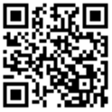
Session Survey
Your feedback is very important to us
Please take a moment to complete the session survey found in the mobile app
Use the QR code or search for “Converge360 Events” in your app store
Find this session on the Agenda tab
Click “Session Evaluation”
Thank you!

Slide 3
Design Principals
Prepar HCI Environment
Deploy AVD Infrastructure
Securing access to Session hosts
Demos

Slide 4
Feel free to ask questions

Slide 5
Prepeare

Slide 6
General Assumptions
Entra ID Tenant
Entra ID Cloud Sync
Azure Stack HCI
General AVD Knowledge

Slide 7
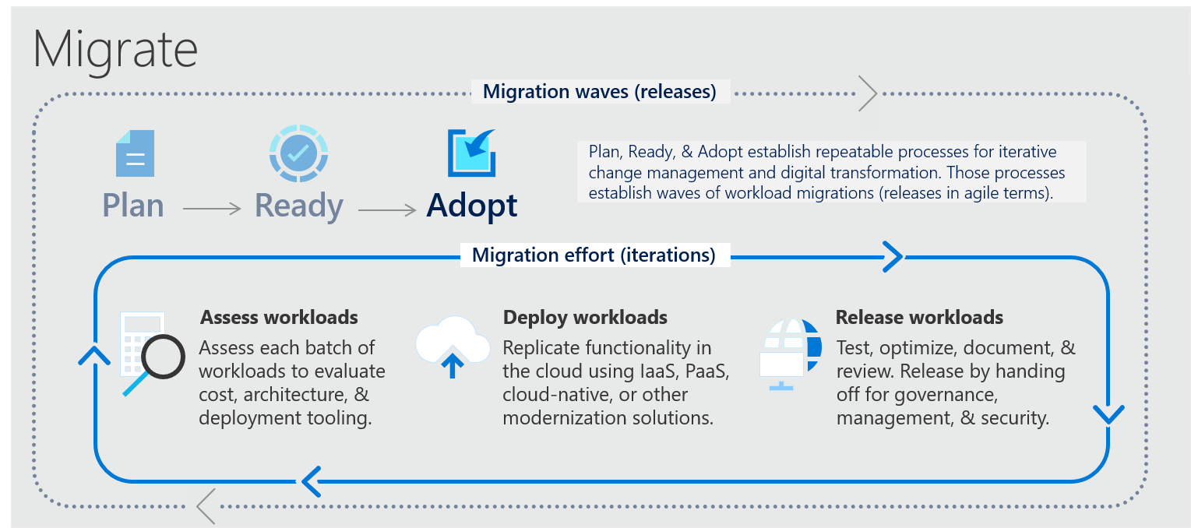

Slide 8
Design

Slide 9
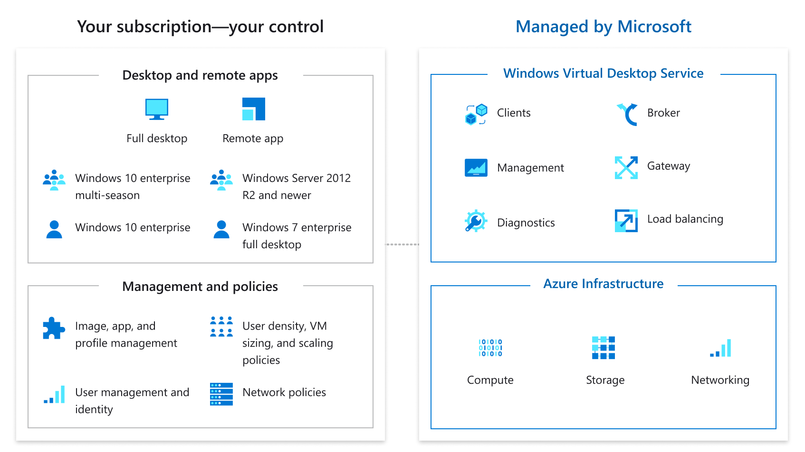
Azure Stack HCI AVD Infrastructure

Slide 10
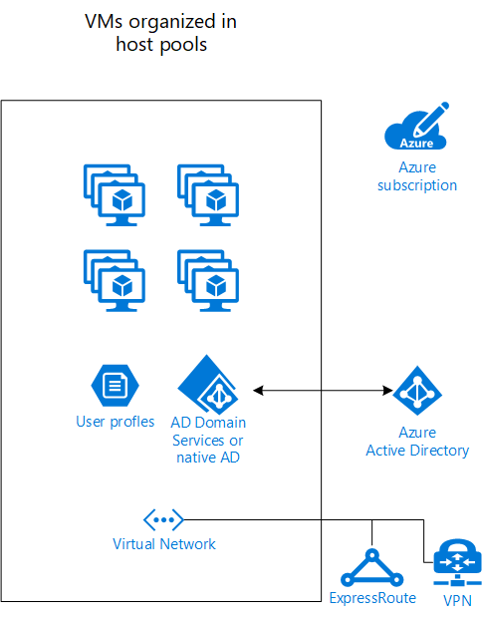
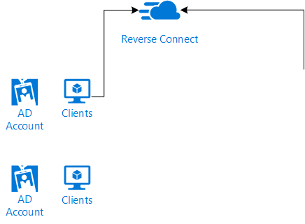
Azure Stack HCI AVD Infrastructure
What to you need at least:
Classic AD environment
Synced directories (AD->Entra ID)
Azure subscription
Virtual Machines
Storage for profiles and other stuff
Clients
Good to have
VPN/Express route to local data center if needed
Monitoring, scaling, etc.

Slide 11
Azure Stack HCI AVD Infrastructure

Slide 12
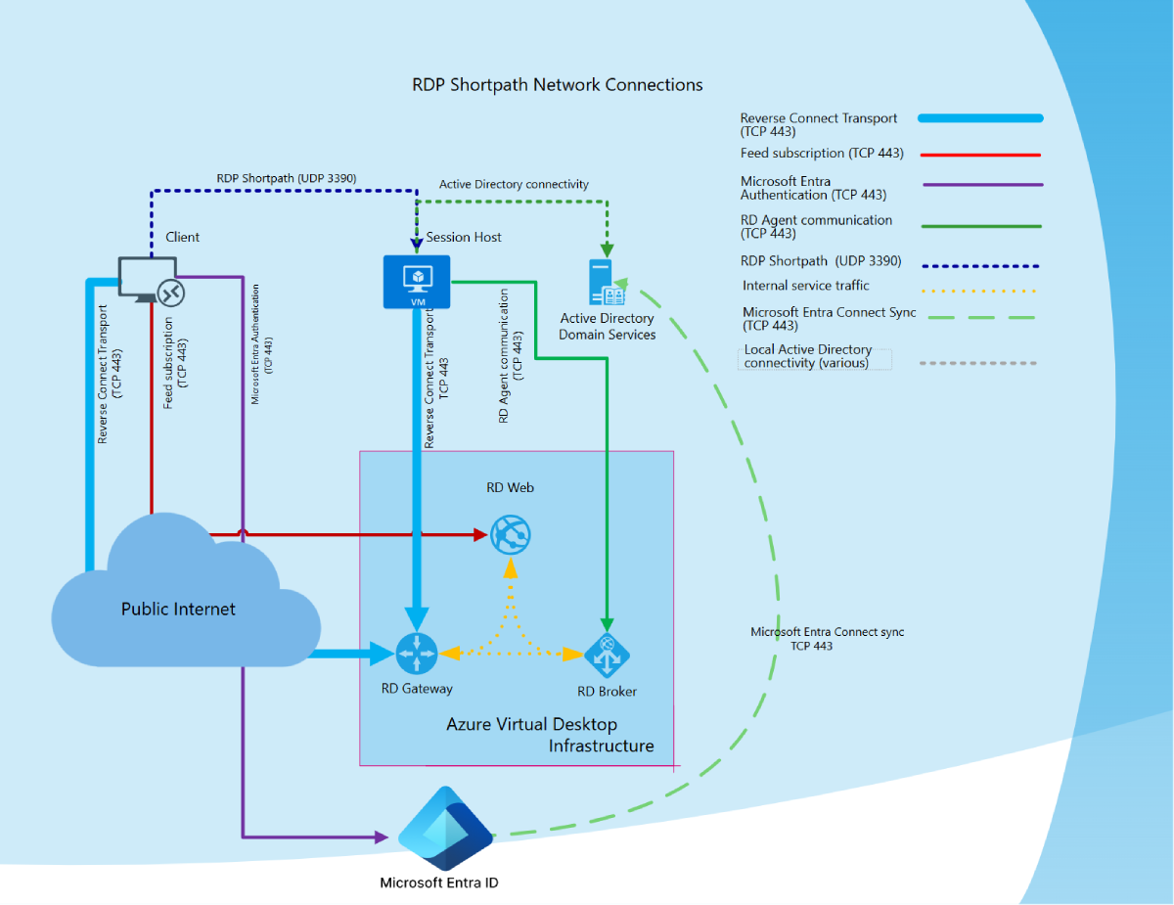
RDP Shorth Path

Slide 14
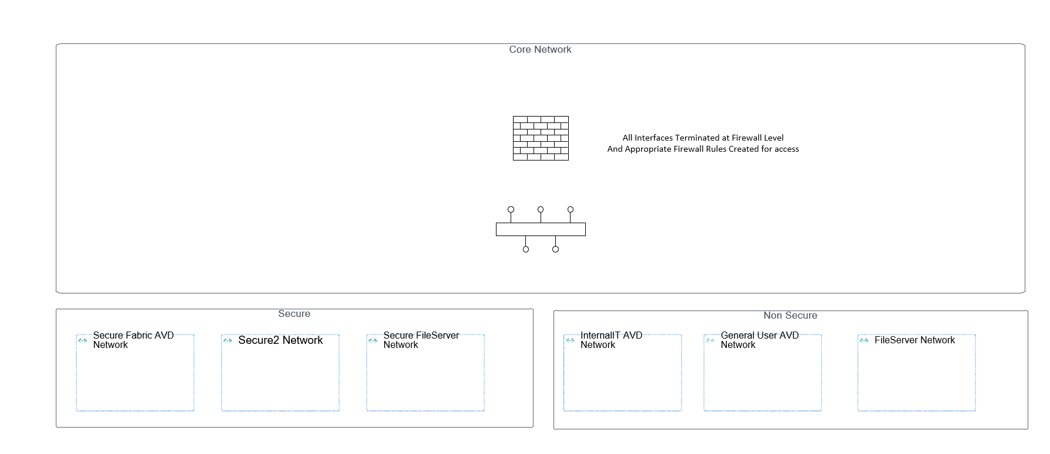
Network Conceptual Design
NO Incomming Firewall Openings
Minimal Incomming Firewall Openings

Slide 15
Login Flow

Slide 16
Deployment Process

Slide 17
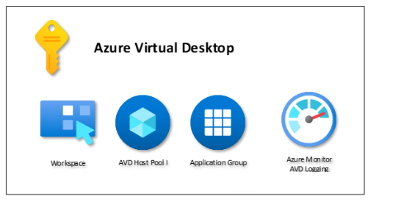
Prepare in Azure

Slide 18
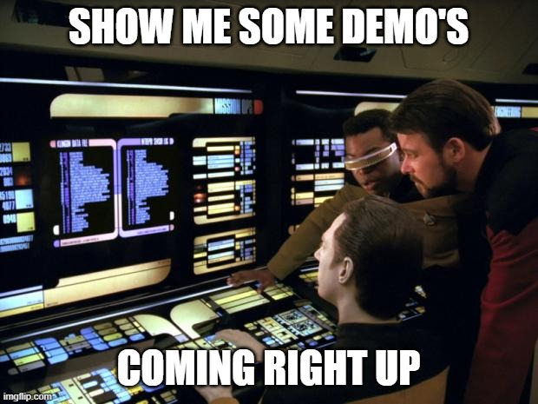

Slide 19
Imaging

Slide 20




Imaging Aproches
Master VM
Preparation
Sysprep + Generalize
Image
Windows 11
Installation and configuration with Intune
Generalize Windows, often more difficult than expected
Generate an image

Slide 21
Imaging Aproches
Master VM
Preparation
Temporary VM
Sysprep + Generalize
Image
Windows 11, domain-joined or not
Installation and configuration with Intune
Exact copy of the Golden Master
Generalize Windows, often more difficult than expected
Generate an image
Makes a copy from the Golden Master
Works with the copy (temporary VM)
Sysprep
Generalization & grab the image
Remove temporary VM
The Golden Master can be reused

Slide 22
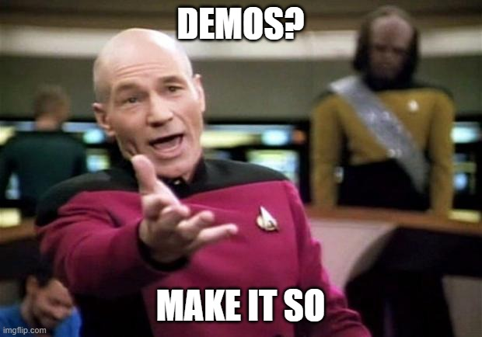

Slide 23
Prepare FSLogix File Shares

Slide 24
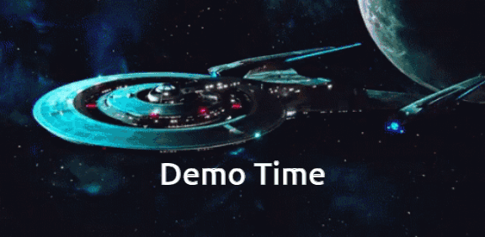

Slide 25
Prepare Security Settings

Slide 26
Group Policy or Intune Policy’s
Group Policy
On-Prem Only Management
Granular Policies
For AD joined Devices
Fast to roll out policys 90 sync interval
Can still do everything
Not very good insights into Group Policy
Legacy On-premis monitoring + Azure Monitor and AVD Monitoring
Intune
Hybrid and Cloud Managed
Standard Policies and Applications
For AD and Entra ID/Intune Joined/Hybrid
Slow to roll out policy 8 hour interval
Does not have all types of policies as GPO
Full Policy Insights from the portal
Full Intune client insights + Azure Monitor and AVD Monitoring

Slide 27
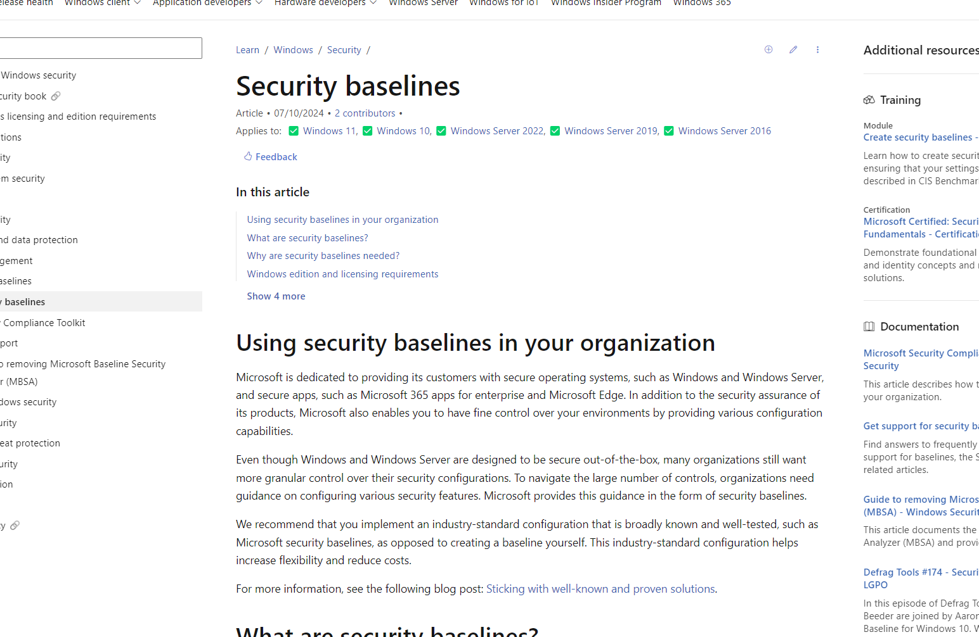
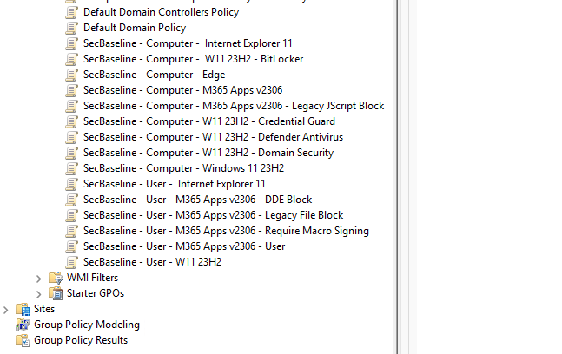
Security baselines
https://learn.microsoft.com/en-us/windows/security/operating-system-security/device-management/windows-security-configuration-framework/windows-security-baselines

Slide 28
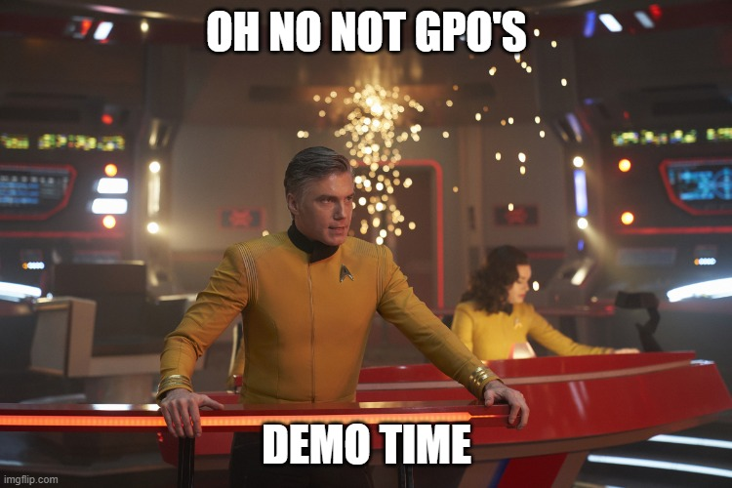

Slide 29
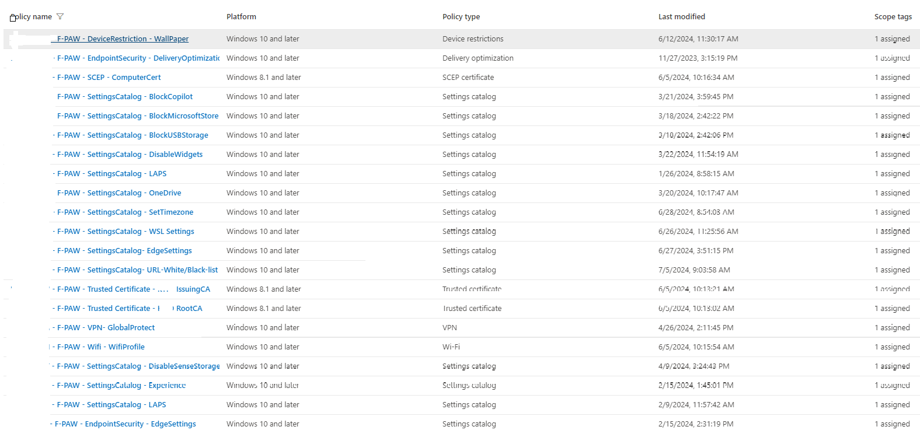

Slide 30
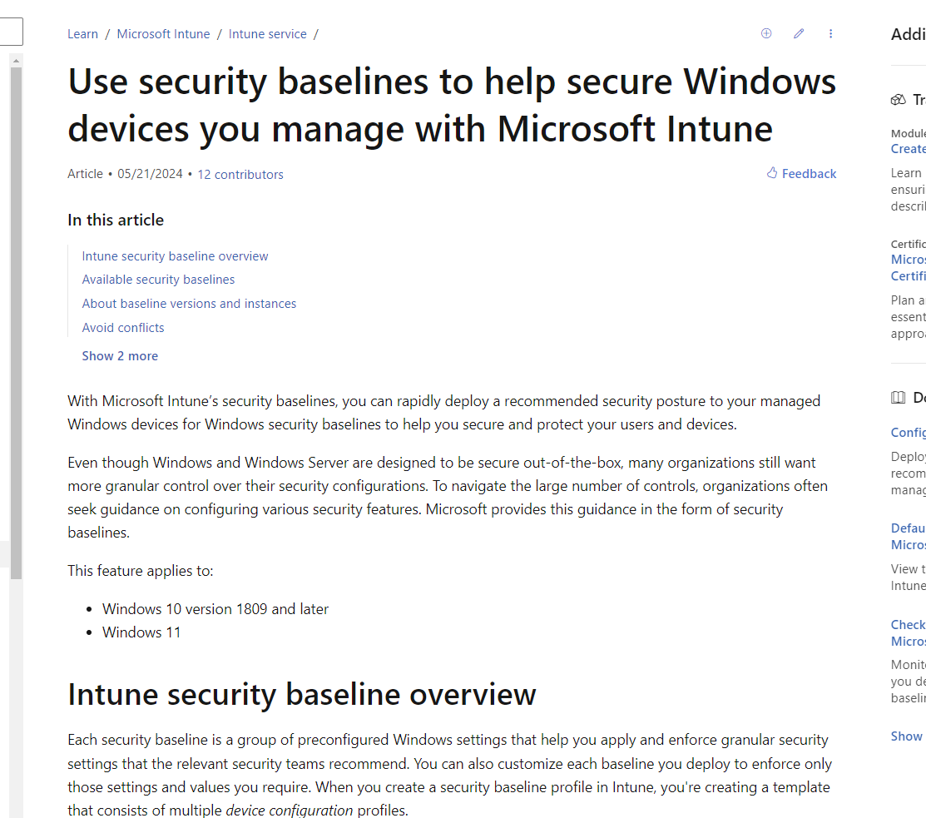
Intune Windows Devices Baseline
https://learn.microsoft.com/en-us/mem/intune/protect/security-baselines

Slide 31
Deployment Time

Slide 32
Deployment ways
Azure GUI
ARM with JSON Template
3rd Party tools
Hydra
Nerdio

Slide 34
How do i connect?
Web URL
Remote Desktop App

Slide 35
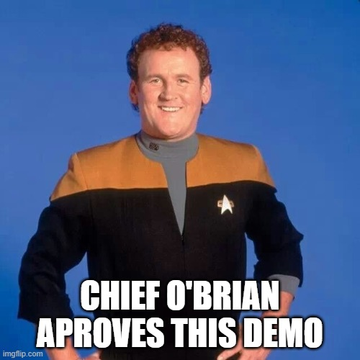

Slide 36
Cost
AVD costs an additional $0.01 per hour per session host 😕
Autoscaling
Integrated with the Azure Portal
Smart with Hydra for AVD or Nerdio

Slide 37
Thank You
Scripts and links bellow
https://github.com/jantorep/techmentor/avd
https://learn.microsoft.com/en-us/azure/virtual-desktop/azure-stack-hci-overview
https://learn.microsoft.com/en-us/azure/cloud-adoption-framework/scenarios/azure-virtual-desktop/ready

Slide 38
Session Survey
Your feedback is very important to us
Please take a moment to complete the session survey found in the mobile app
Use the QR code or search for “Converge360 Events” in your app store
Find this session on the Agenda tab
Click “Session Evaluation”
Thank you!

